Slide 1
Reproducibility
Nightmare!
Plants_R_Amazing
Modestos, Sadiya,
Onyinyechi, Catherine

Slide 2


Slide 3
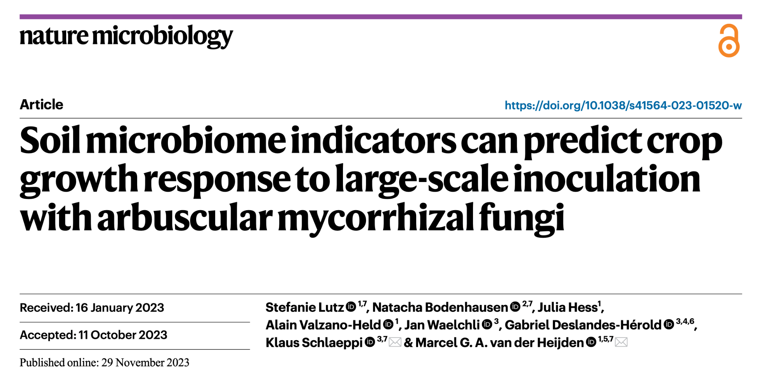

Slide 4
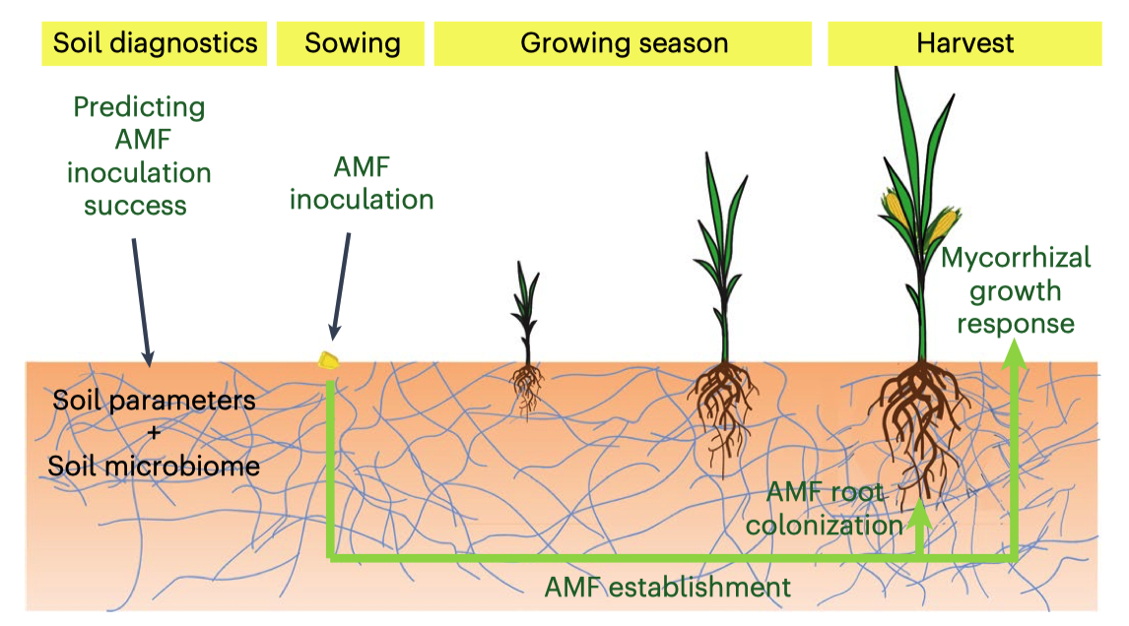
Experimental Setup of the Field Inoculation Trials

Slide 5
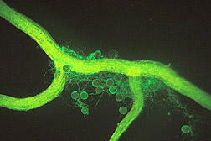
Key findings of the study
Inoculation with AMF strain R. irregulare (SAF22) resulted in highly variable mycorrhizal growth responses (MGR) in maize across 54 fields in Switzerland
Only ~25% of fields (14/54) exhibited significant positive biomass increases (i.e., high MGR)
Soil fungal community composition was the strongest predictor of MGR
13 sOTUs (soil operational taxonomic units) explained 53% of MGR variance
15 soil parameters explained 29% of MGR variance

Slide 6
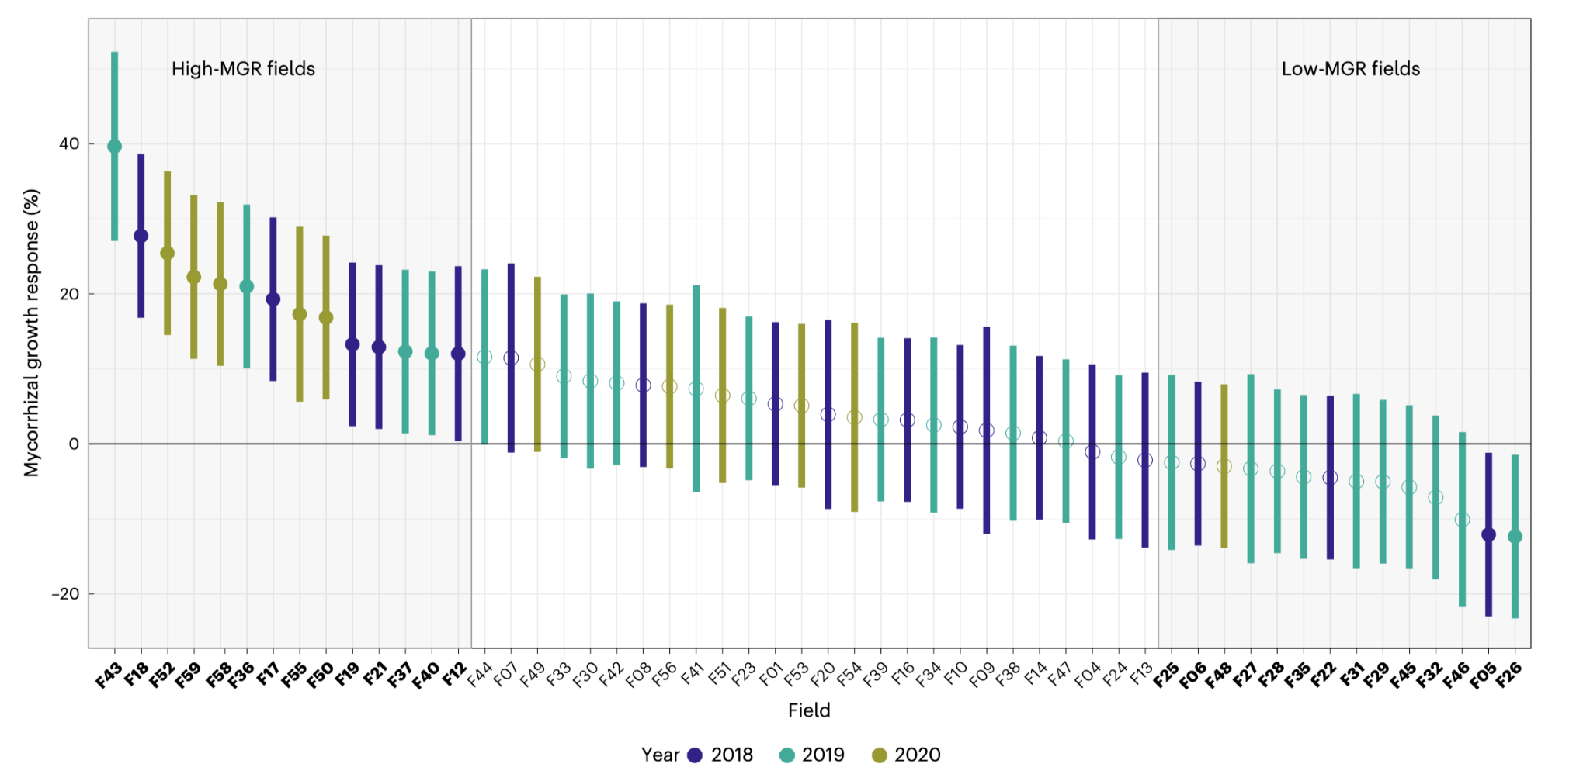
Mycorrhizal Growth Response (MGR) over 3 Years

Slide 7
Soil microbiome indicators of MGR
Soil pathogenic fungi (i.e., Trichosporon, Olpidium) are the most important predictors of MGR
Successful establishment of AMF on maize roots suppresses pathogenic fungi and triggers induced systemic resistance, resulting in high MGR
This proof-of-concept study demonstrated the potential of using soil fungal indicators as a diagnostic tool to guide AMF inoculation decisions

Slide 8
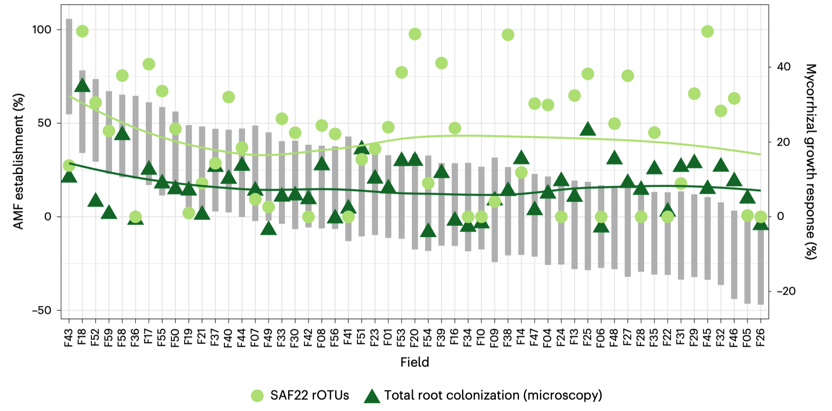
AMF Establishment in the Roots

Slide 9
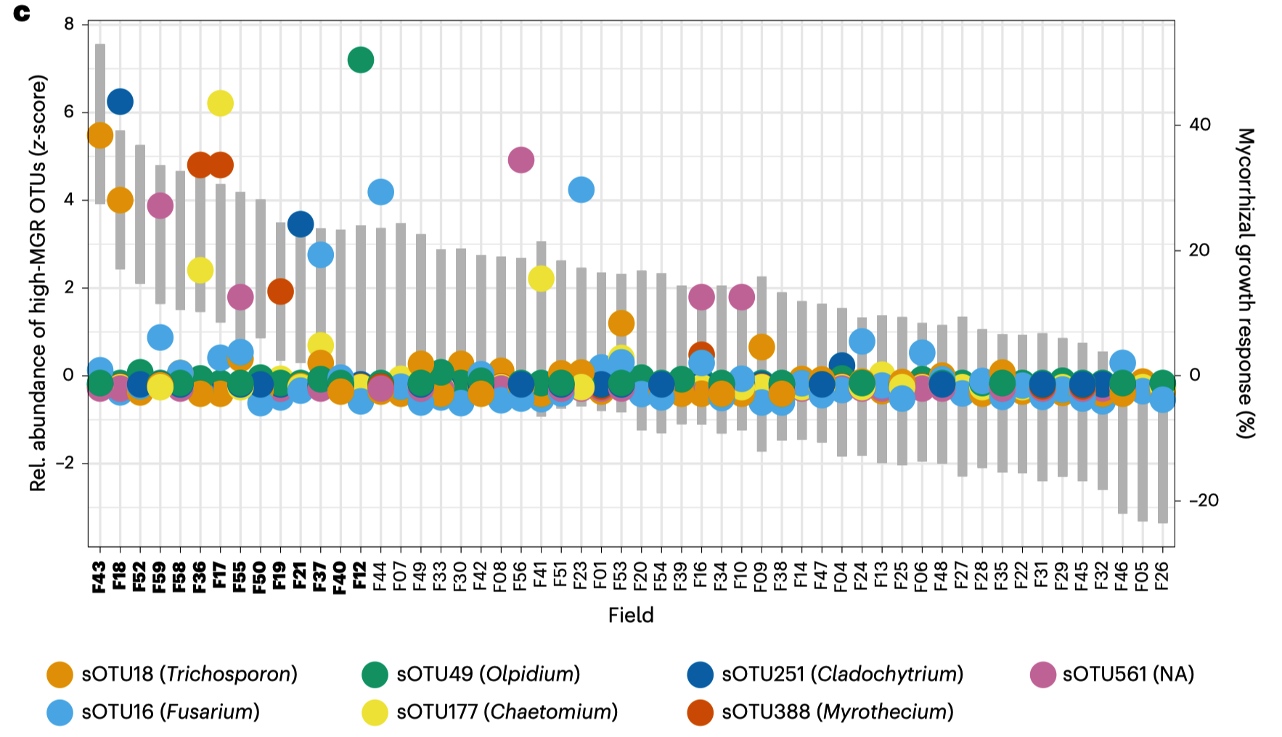
Relative Abundance of soil fungal OTUs and MGR

Slide 10
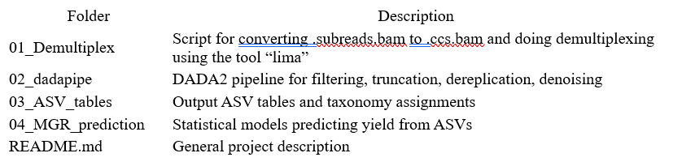
Demultiplexing
The project started with the realization that we do not have the “subreads.bam” files (the github scripts try to load files named *.subreads.bam). This means we cannot remake the CSS reads or do the demultiplexing ourselves, because we aren’t given the data necessary to do so.
Data provided are fastq zip files.
We have to skip Demultiplexing
Next step in pipeline is Dada2.

Slide 11
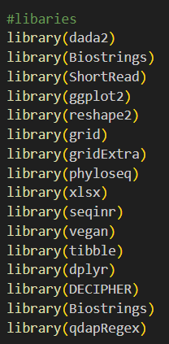
dada2 pipeline
Dada2 (Pacbio) is slow and difficult to install
We used Bioconductor
Other libraries were not easy either
Versions were different
Tried running on Nova but sudo permissions required.
Created a different environment, still didn’t work
Slurm script required change of account since class account shows “quality specification” error.
We tried using “scavenger” as quality specification. That didn’t work either
Hours of work and multiple attempts
Path to many files was very incorrectly setup without any indication to change it.
Finally ran on nova interactive session.
It ran for a week on another HPC cluster
Changed part of script to make it run.

Slide 12
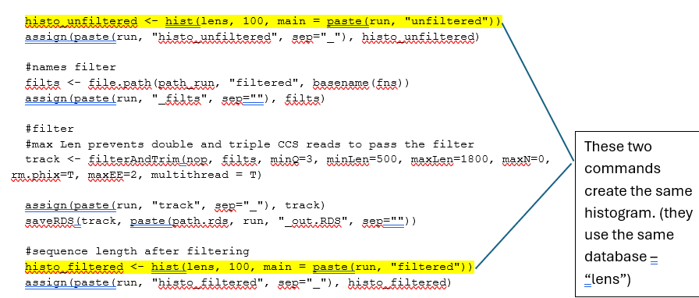
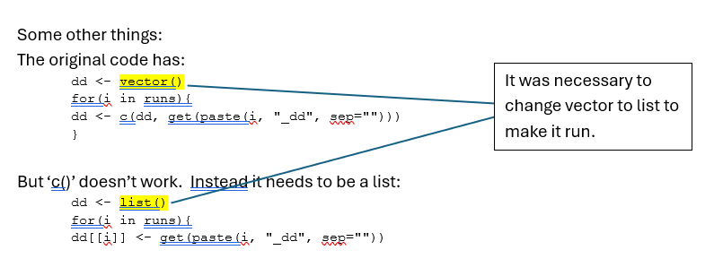
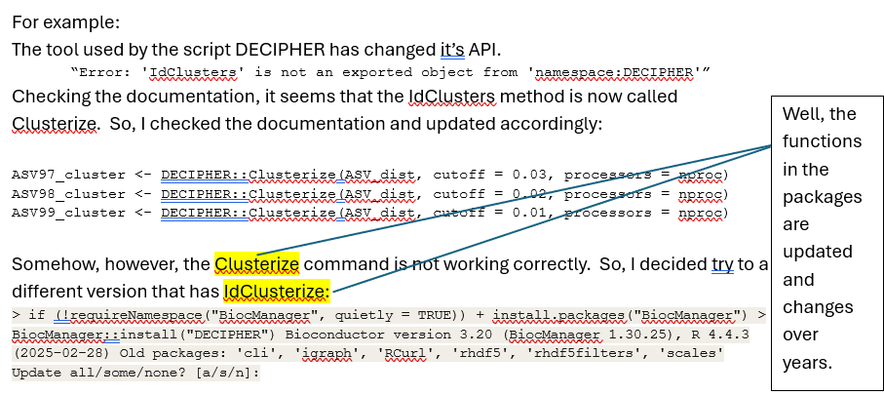
dada2 pipeline Code Change
Code Cleaning
Used same data for histogram
Change updated function name
Change to vector

Slide 13
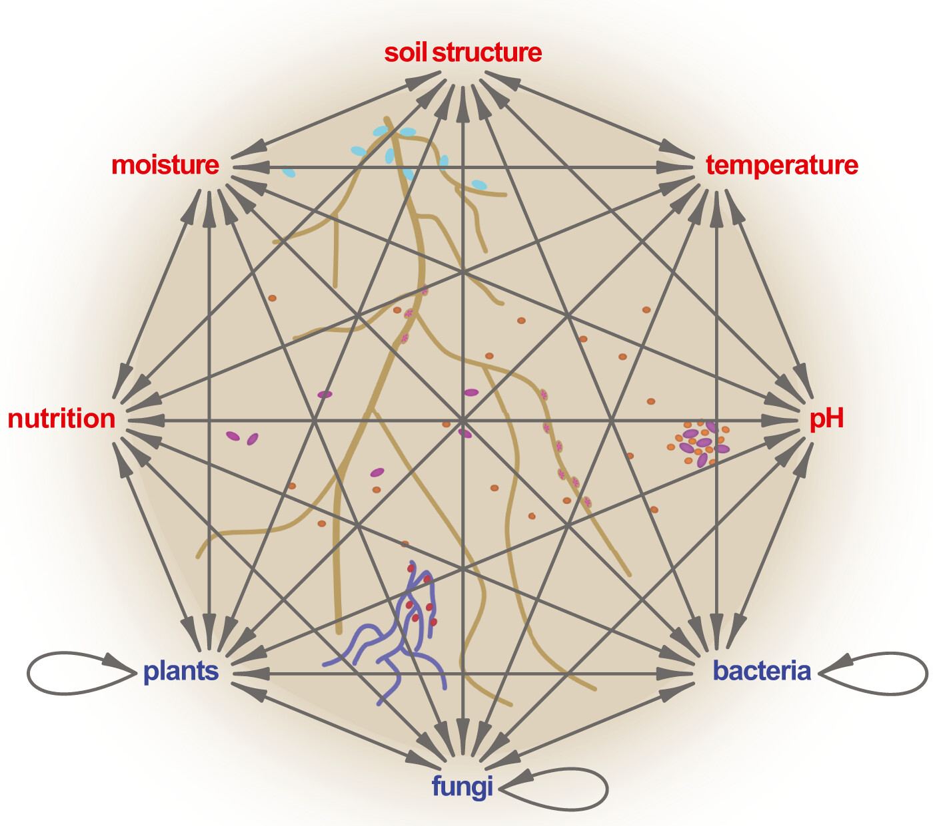
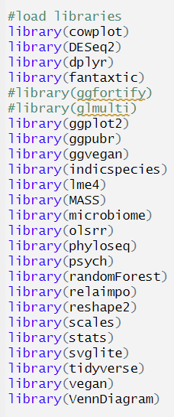
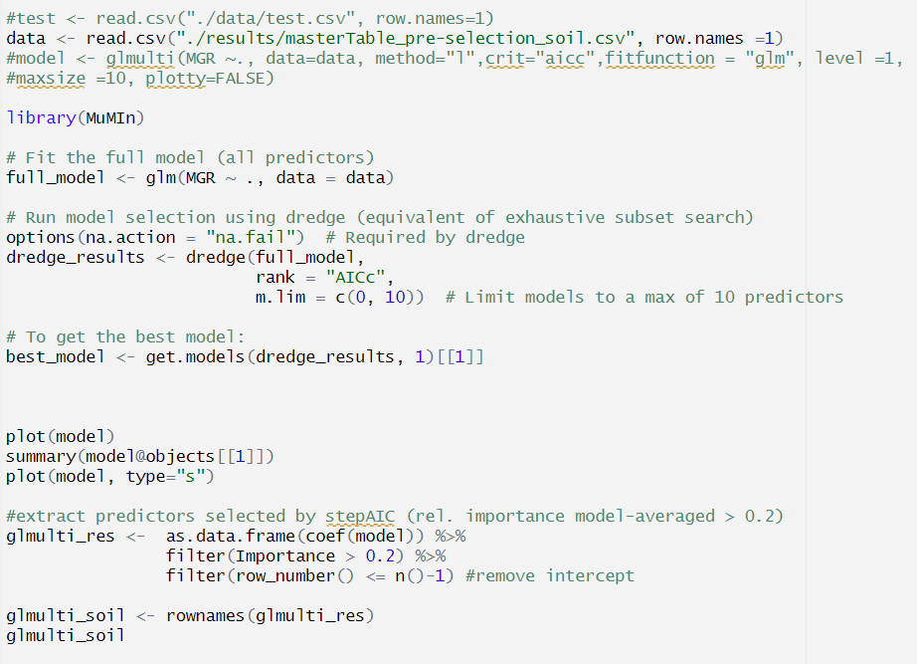
MGR Prediction - R Code
One file for all (soil and root)
GitHub repository or bioconductor for package installation.
Skipped difficult unimportant packages
rJava compatibility trouble with glmulti
Trouble package - ggvegan
Ran two models -
glmulti
MuMIN

Slide 14
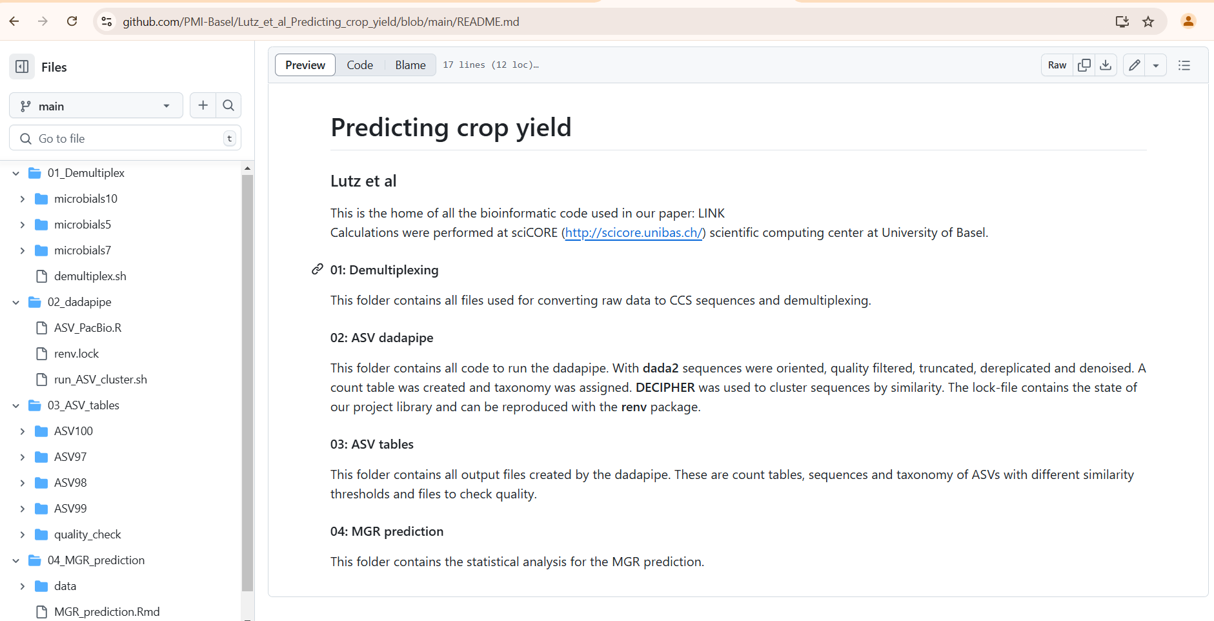
Overview of Group Documentation
Screenshot of paper’s GitHub page

Slide 15


We thought it wouldn’t be hard but, no.
AVALANCHE!

Slide 16
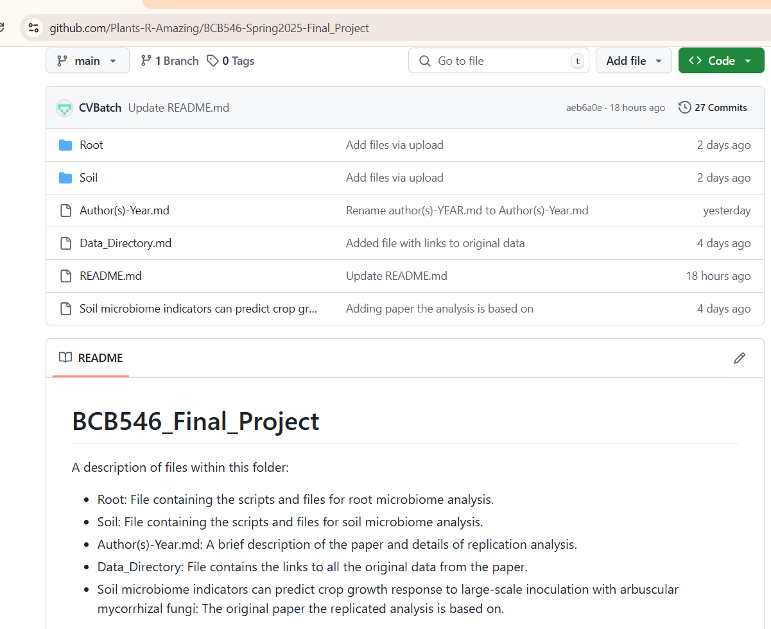
Documentation layout

Slide 17
Group’s Documentation Overview
Author(s)-Year.md - Summary of paper and replication goals.
Data_Directory.md - Links to raw sequencing data and metadata.
README.md - Description of files and folders in the repository.
Soil/ - Scripts and files for soil microbiome analysis.
Root/ - Scripts and files for root data analysis.
Soil microbiome indicators can predict crop growth response to large-scale inoculation with arbuscular mycorrhizal fungi.pdf - Original paper by Lutz et al. (2023).

Slide 18
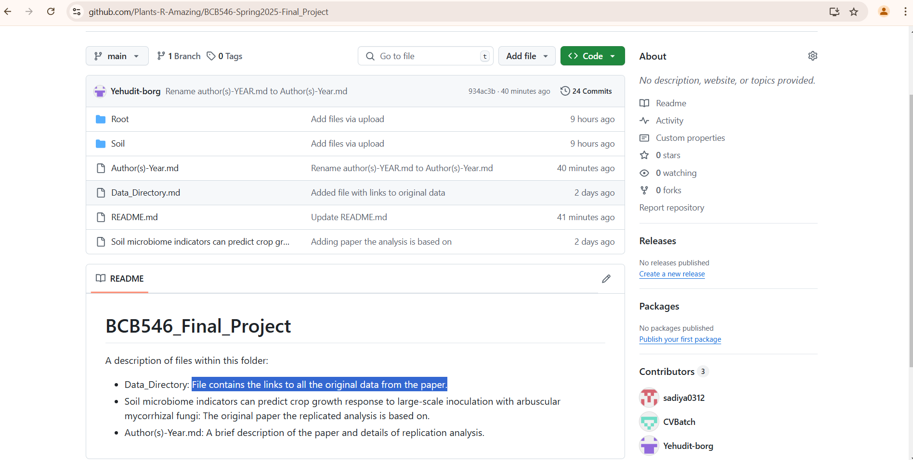
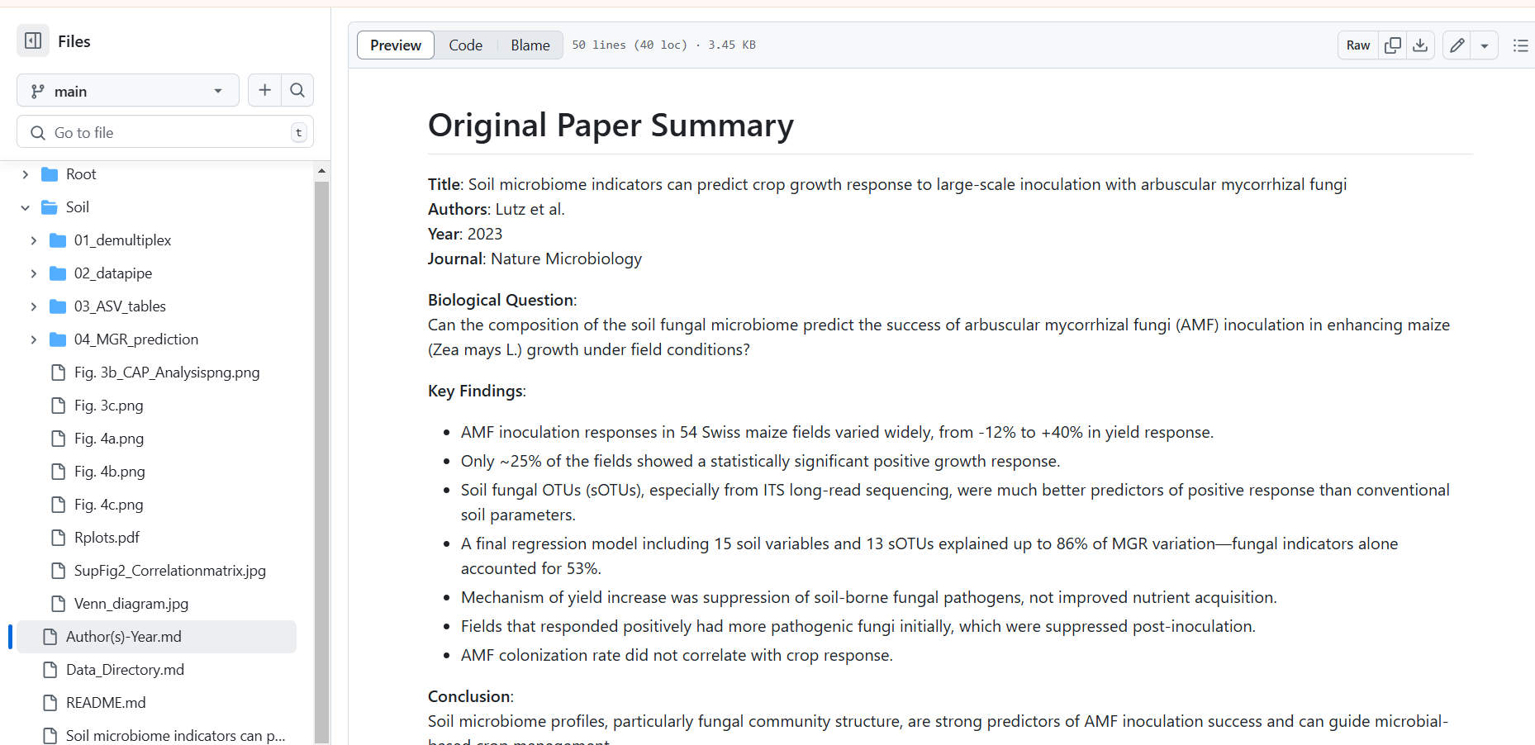
README.md File
Author(s)-Year.md

Slide 19
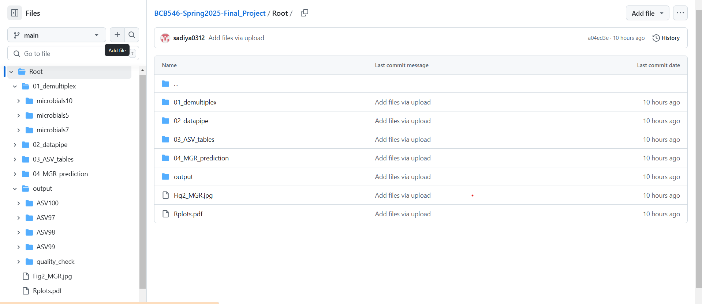
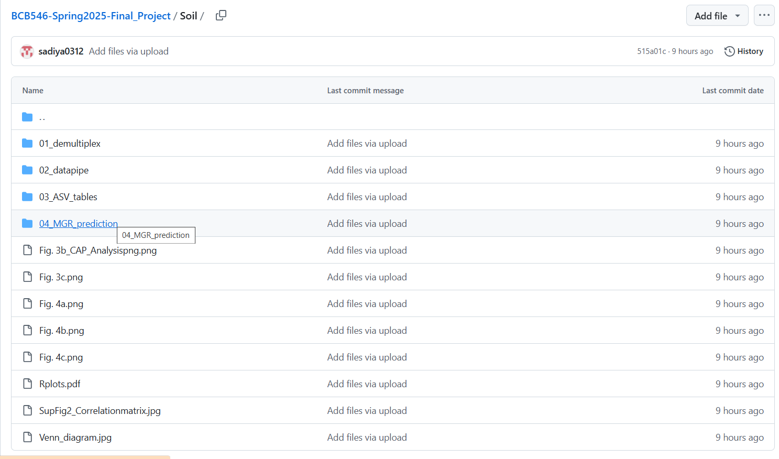
Root Directory
Soil Directory

Slide 20
Comparing Documentation
The readme code does not describe what the tools do.
The pathway of the files did not correspond to how the code was actually running. Hence, the command didn’t run.
The code repeatedly created new files and then deleted them every time we ran it.
The Lima command was not found, but prints as demultiplexed.
They had outdated versions of the modules and misused the capitalizations when writing samtools = SAMtools

Slide 21

Our Analysis vs. Paper’s Analysis

Slide 22
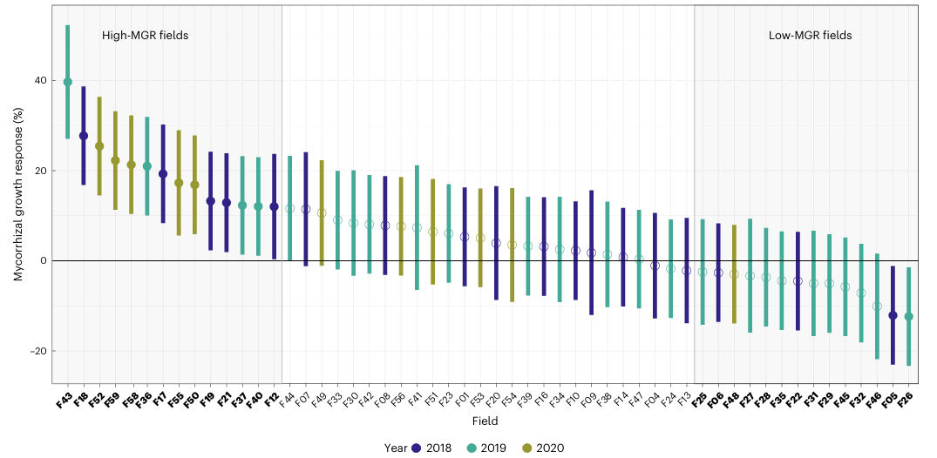
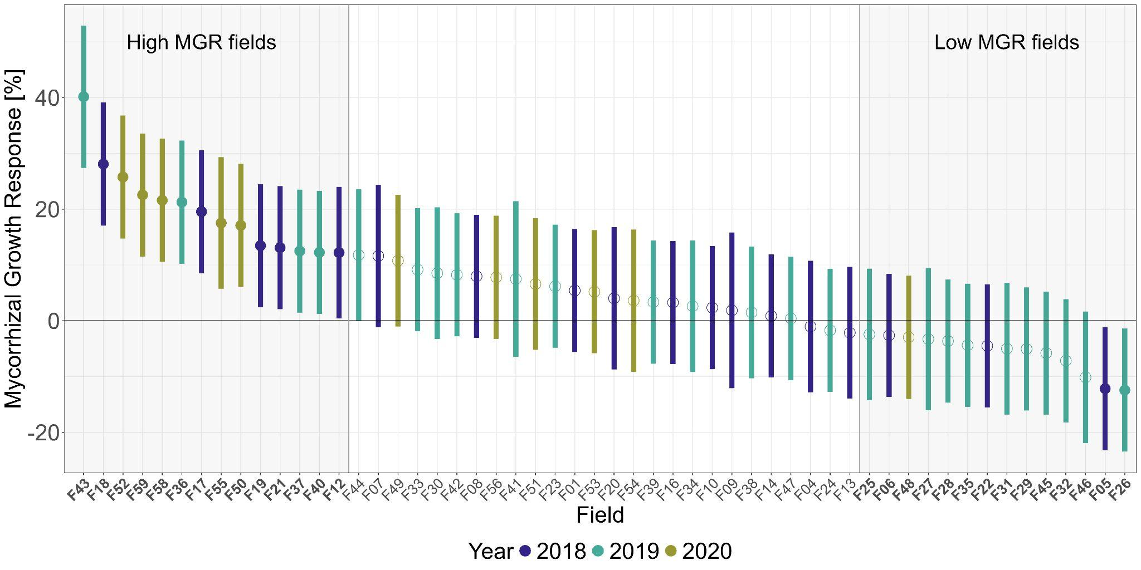
Mycorrhizal growth response over 3 years
Paper
Our Diagram

Slide 23
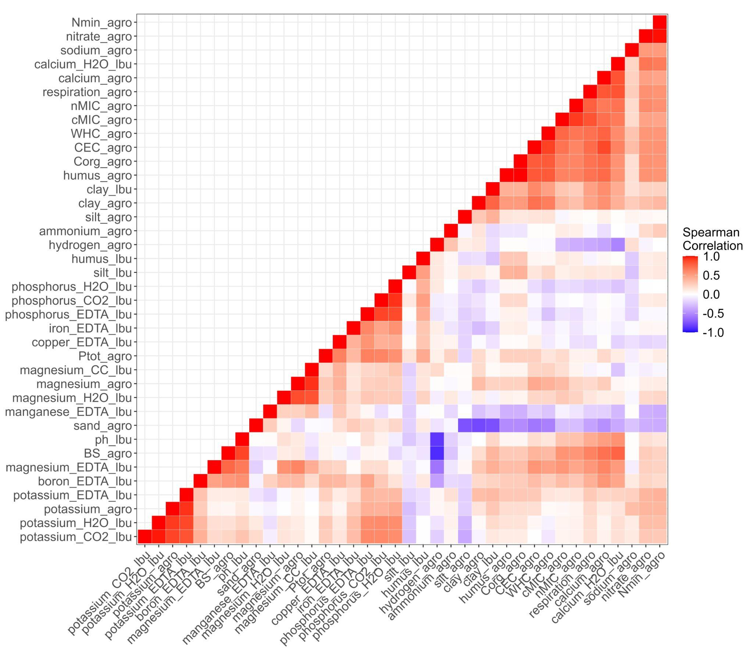
Most Important Soil Parameters for MGR Prediction
52 soil parameters considered
38 parameters using data available for all fields
22 strongly correlated parameters

Slide 24
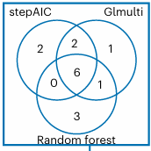
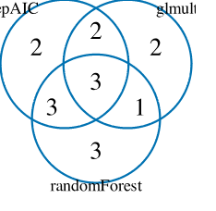
Further Reducing Soil Parameters
Paper
Our Diagram

Slide 25
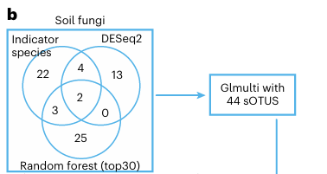
Most Important Soil OTUs for MGR Prediction

Slide 26
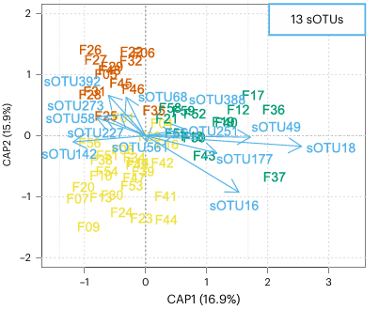
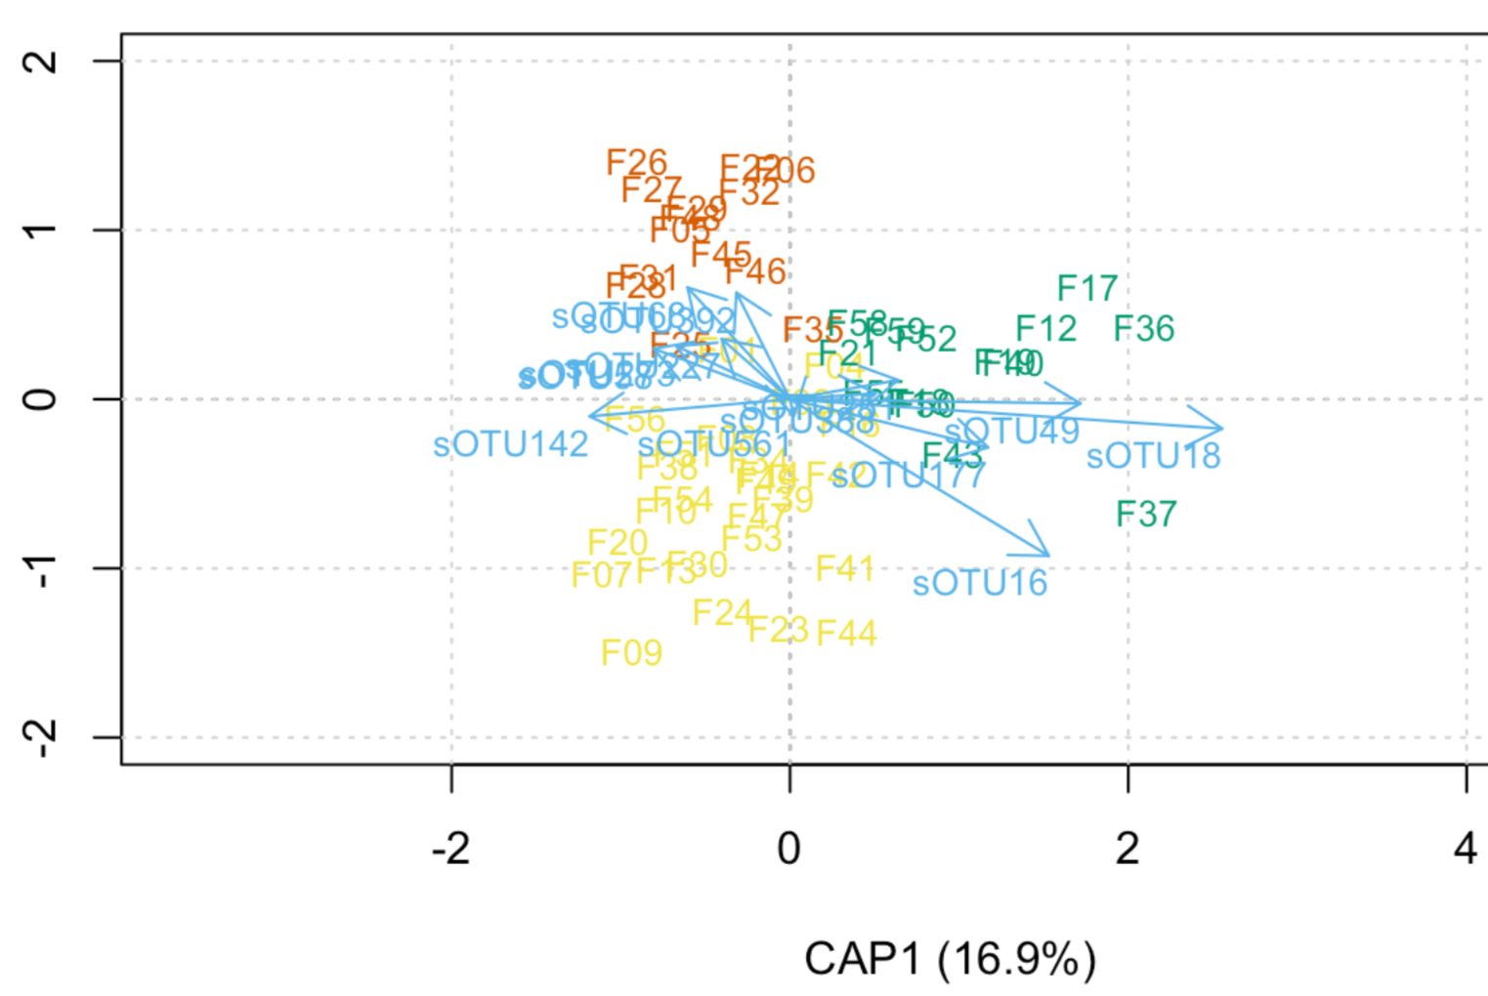
Most Important Soil OTUs for MGR Prediction
Paper
Our Diagram

Slide 27
Conclusion and main takeaways
Clean up code before publishing
Make a more detailed ReadME
Use proper data structures
Mention the tools/programs needed for the analysis
Make sure all the file names match the file names used in the code
Provide raw files as a zip file and all primers

Slide 28
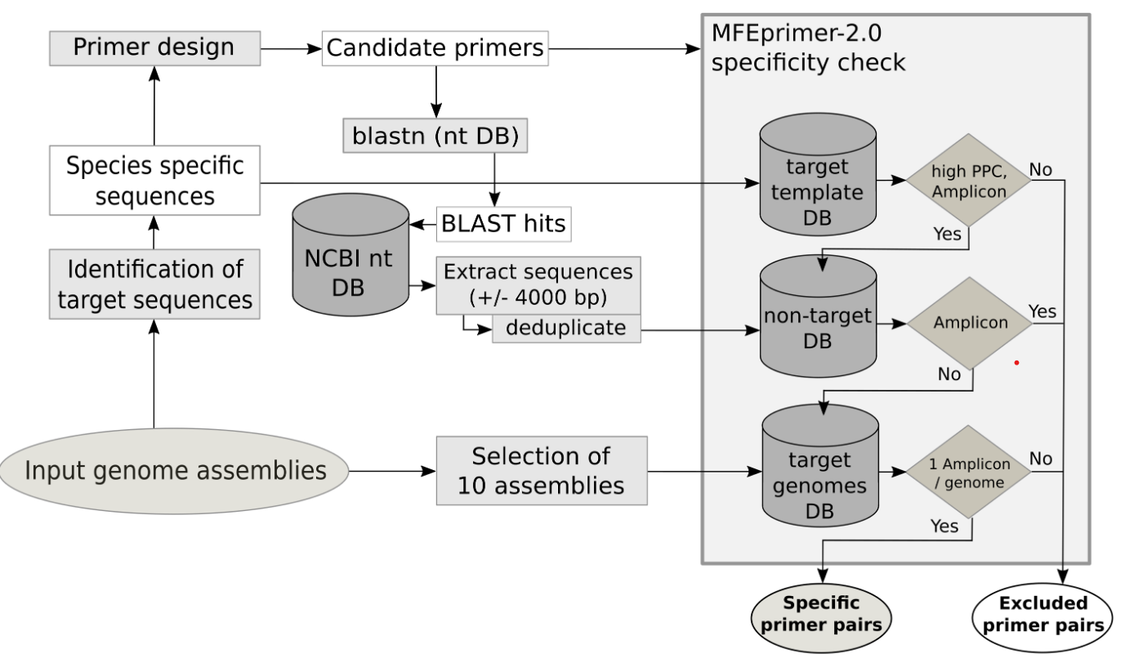
Ways of Improving
Add a pipeline image describing the route of data analysis
Dreier et al., (2020)

